Slide 1
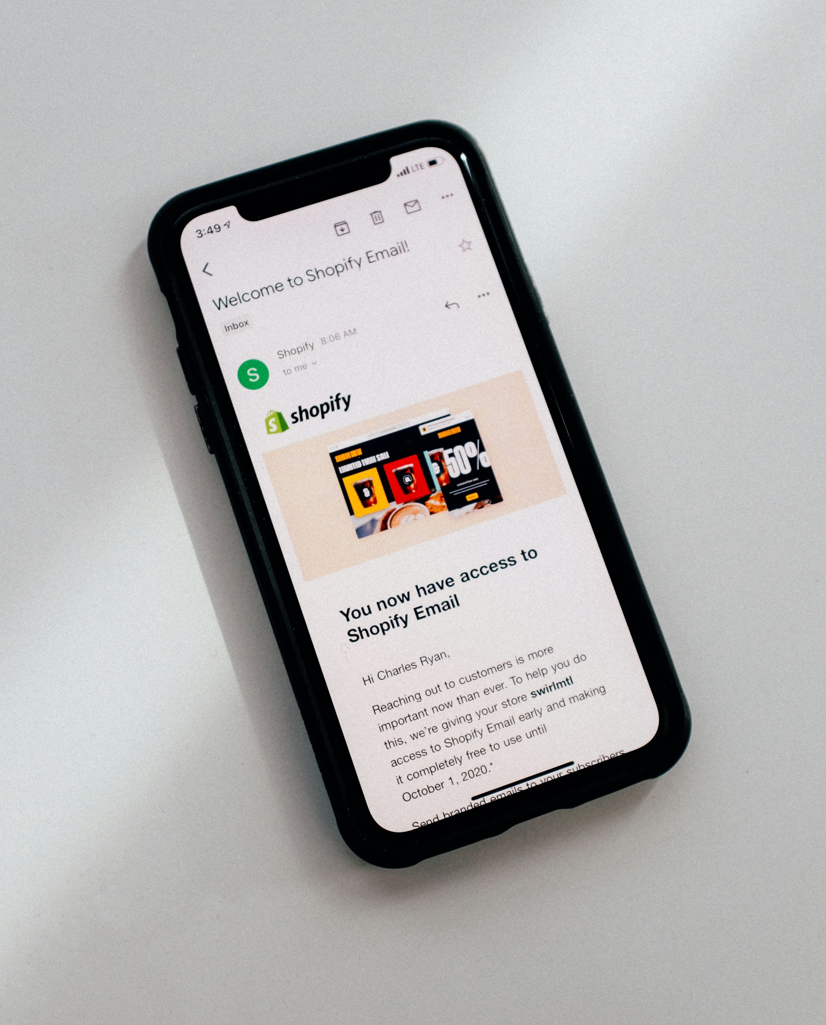
01
DIGITAL FORENSICS
Email Forensic Tools
BATCH - 02

Slide 2


DIGITAL FORENSICS
ABOUT US
211FA19002 Y.V. PRANAY KUMAR
211FA19008 S. VASU VAMSI KRISHNA
211FA19023 A. BASANTH
211FA19056 P. SNIKITHA

Slide 3
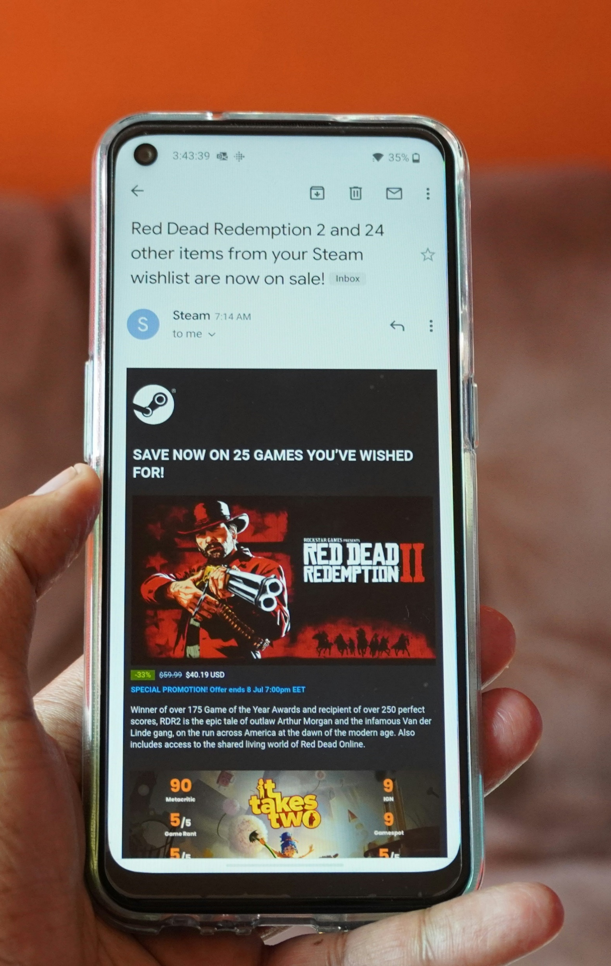
03
ABOUT EMAIL FORENSICS
Digital communications analysis and investigation need the use of email forensics tools. These technologies support email recovery, email metadata tracking, and unwanted access detection.
Email forensics is the analysis of the source and content of the email message, identification of sender and receiver, date and time of email, and the analysis of all the entities involved. Email forensics also reforms the forensics of client or server systems suspected in an email forgery.

Slide 4

04
AID4MAIL
“
Specialized email forensics tools, like Aid4Mail, are made to help investigators with several facets of digital forensics by analyzing email headers and evidence. These technologies include features and capacities that are essential for looking into crimes involving emails and legal problems.

Slide 5
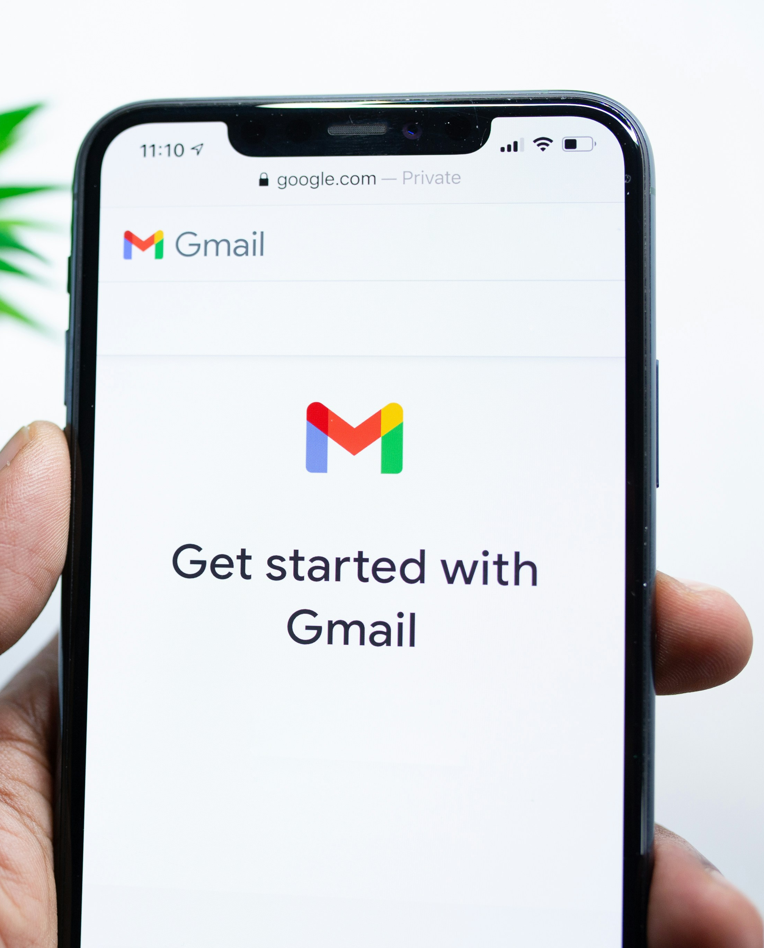

05
CAPABILITIES
Recovering Deleted Emails
Aid4Mail excels in uncovering hidden or seemingly lost information, including deleted or corrupted emails.
Reconstructing Email Conversations
By analyzing email headers and content, Aid4mail can help investigators reconstruct email conversations.
Identifying Evidence of Spoofing
Email forensics tools can analyze metadata, including timestamps, IP addresses, and other indicators, to identify signs of tampering or spoofing.

Slide 6
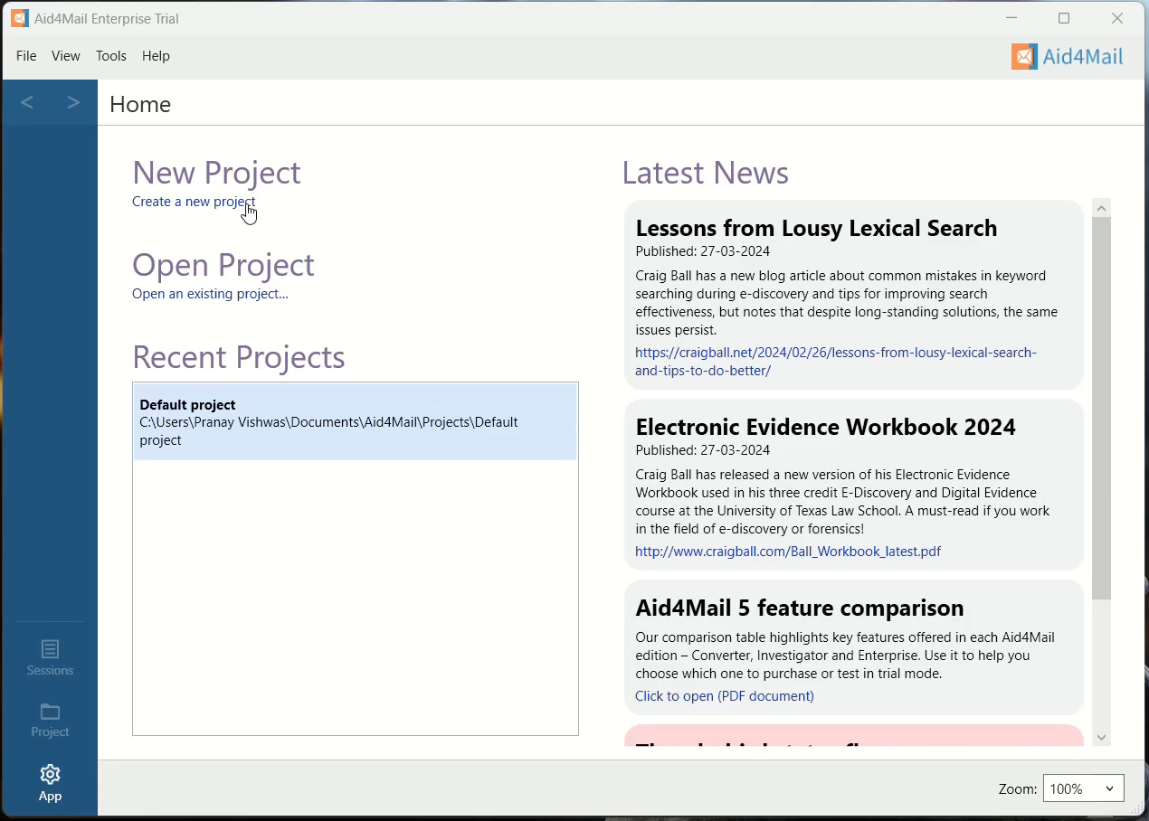
06
WALKTHROUGH

Slide 7

07
EMAIL HEADERS
Let’s see few of Email Headers
and their importance
Break slide

Slide 8
08
Received SPF
EMAIL HEADERS
Pass: Email is acceptable
Soft fail: It’s possible to create a bogus source
Fail: source is illegal
Unknown: SPF check can’t be performed
01.
SPF, or Sender Policy Framework, is an email validation protocol designed to detect and block email spoofing. It allows mail exchangers to verify that incoming mail from a specific domain comes from an IP Address authorized by that domain’s administrators. Here are the codes

Slide 9
09
DomainKeys Identified Mail
EMAIL HEADERS
01.
DKIM lets an organization (or handler of the message) take responsibility for a message that is in transit. DKIM attaches a new domain name identifier to a message and uses cryptographic techniques to validate authorization for its presence. Some of the tags are used:
v: version
a: signing algorithm
d: domain
s: selector

Slide 10
10
Domain-based Message Authentication Reporting and Conformance
EMAIL HEADERS
(DMARC) is a free and open technical specification that is used to authenticate an email by aligning SPF and DKIM mechanisms. Email is involved in more than 90% of all network assaults, and without DMARC, determining whether an email is authentic or false can be difficult. DMARC allows domain owners to protect their domain(s) from unauthorized use by fighting phishing, spoofing, CEO fraud, and Business Email Compromise.

Slide 11
11
ARC
ARC aids in the preservation of email authentication results and confirms the identification of email intermediaries who forward a message to its intended recipient. ARC is made up of three main components.
ARC-seal - additional DKIM-like signature with the ARC Signature and ARC Authentication-Results header data.
ARC-Message-Signature - a DKIM-like signature that takes a snapshot of the message header information, including the to, from, subject, and body.
ARC-Authentication-Results - a header containing email authentication results like SPF, DKIM, and DMARC.
EMAIL HEADERS

Slide 12

THANK YOU
B
A
T
C
H
2
12

